Slide 1

“ SUPPORT VECTOR MACHINE ”
TECHNOLOGY PROJECT - III
SUBMITTED BY :
1. AMEYA PRASANNA MOTE , 3104966@stud.srh-campus-berlin.de , 3104969
2. CHAITANYA MALPURE , 3105038@stud.srh-campus-berlin.de , 3105038
3. NANMA JOSEPH , 3104969@stud.srh-campus-berlin.de , 3104969
4. SAYLI SOPAN AKARSHE , 3105190@stud.srh-campus-berlin.de , 3105190
Technology Project III – ERP-CSc-0016
Winter’2020 - 26.Oct.-25.Nov.2020

Slide 2
INDEX :
OBJECTIVE
INTRODUCTION
SUPPORT VECTOR MACHINE
WORKING
WHY ONLY SVM
PROS AND CONS
CODE
REFRENCES
FINDINGS AND CONCLUSION
TUNING PARAMETERS
MATHEMATICS BEHIND SVM
DATASET AND PACKAGES EXPLAINED
PRE-REQUISITES
SCIKIT LEARN

Slide 3

OBJECTIVE :
The main goal of our project is to predict the heart rate from certain features using SVM( Support Vector Machine ).
The heartbeat is processed by electrical signals conducted in 4 chambers of heart, i.e. two atria's and two ventricles .
When electrical signals are normal , the heart beats approximately at rate of 60 to 100 times per minute.
However due to the occurrence of certain abnormalities the electrical signal gets disorganized and leads to fasten the heart rate .
When not taken care of this condition it could also lead to fatal conditions like cardiac arrest etc. .

Slide 4
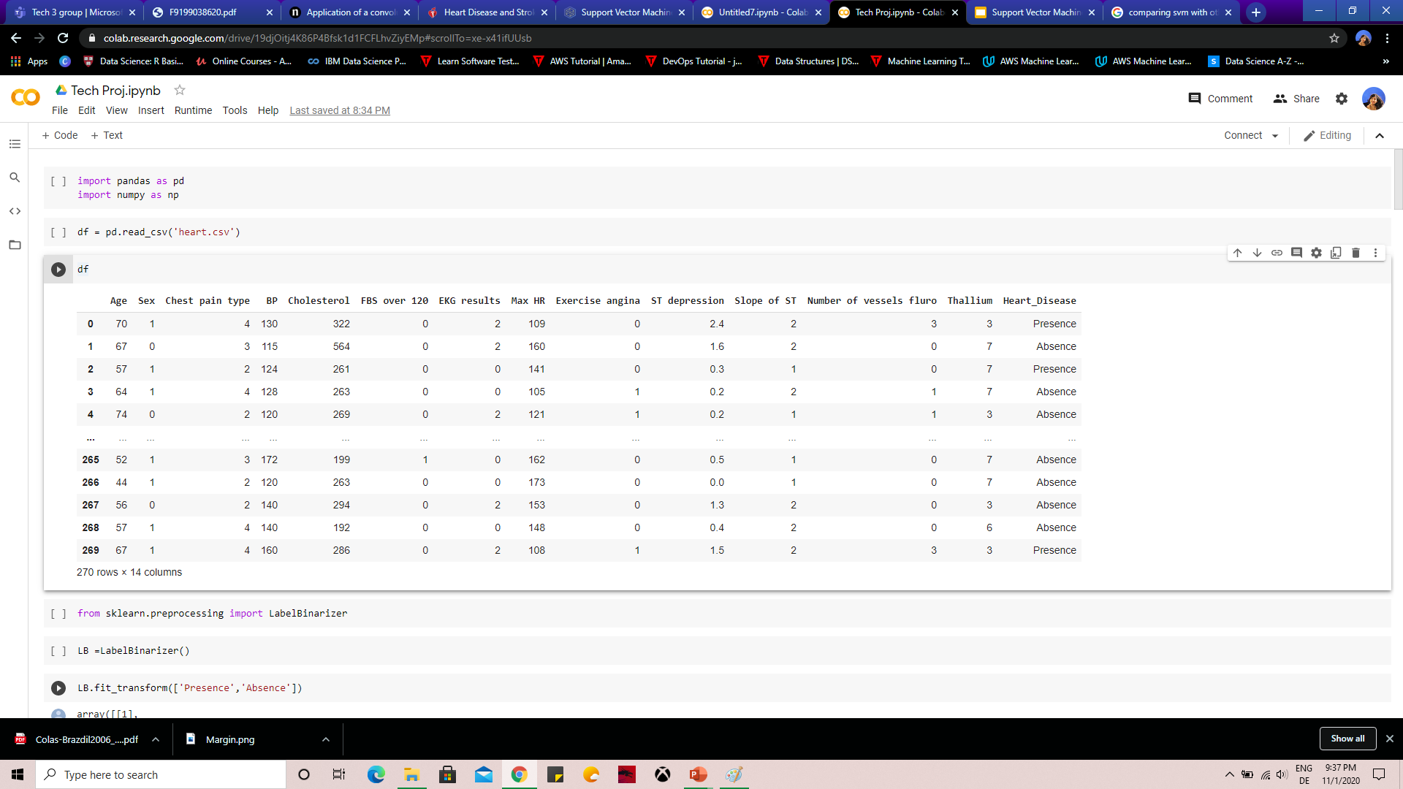
OBJECTIVE :
Here we have used a dataset having features like age ,sex , cholesterol blood pressure etc ..to categorize the different segment of data to into different classes and determine the heart rate
SVM is used in our project to classify different features from the dataset and according to it predict whether the person is having heart disease or not .
SVM ALGORITHM
PATIENT WITH HEART DISEASE
PATIENT NOT HAVING DISEASE
HEART RATE PREDICTION DATASET

Slide 5

INTRODUCTION:
Cardiovascular disease or heart disease, is one of the most fatal condition which occurs due to certain disorders in the blood vessels .
There are many heart diseases like rheumatic heart disease , cerebrovascular disease etc. , out of which cardiac arrest and stroke are the main conditions found normally in humans .
According to world statistics , an estimated amount of 17.9 million deaths occur each year .
In this one-third of the deaths occur in people under the age of 70 years .
The main symptoms include increased blood pressure , overweight , glucose and lipid levels , cholesterol etc.

Slide 6
INTRODUCTION:
Many approaches like machine learning ,neural networks ,data mining have been deployed to identify the disease .
Here we use one of the machine learning model , Support Vector Machine to predict the threat level of the disease at a very early stage .
From the past few decades , it has also been identified that heart disease condition has been also found in new born babies also during their birth itself .

Slide 7
INTRODUCTION:
SVM model mainly helps us to differentiate data in various categories .
It uses hyperplane to differentiate the data so that it is easy to understand under which category the risk possess and which category the risk factors are less .
These models also have helped us to understand the myth of which category of age regarding the heart disease whether, elder people are highly prone or the youngsters are more prone to the CVD .
SVM has also helped us to :
differentiate certain categories like the people who smoke , high blood pressure , higher glucose level , cholesterol etc
to determine the risk at very early stage
to identify under which category the heart disease are more prone
also to identify the accuracy levels they possess .

Slide 8
A QUICK INTRO TO SVM ……………….
Understanding SVM ???
Image A- for linear data
Image B
Any point that is left of line falls into red stars class and on right falls into green circle class.
Separation of classes. That’s what SVM does.
It finds out a line/ hyper-plane in multidimensional space that separates out the classes

Slide 9
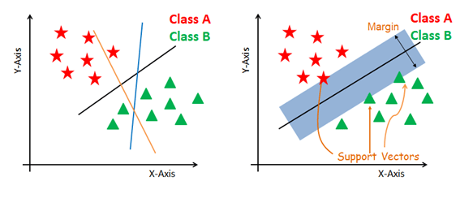
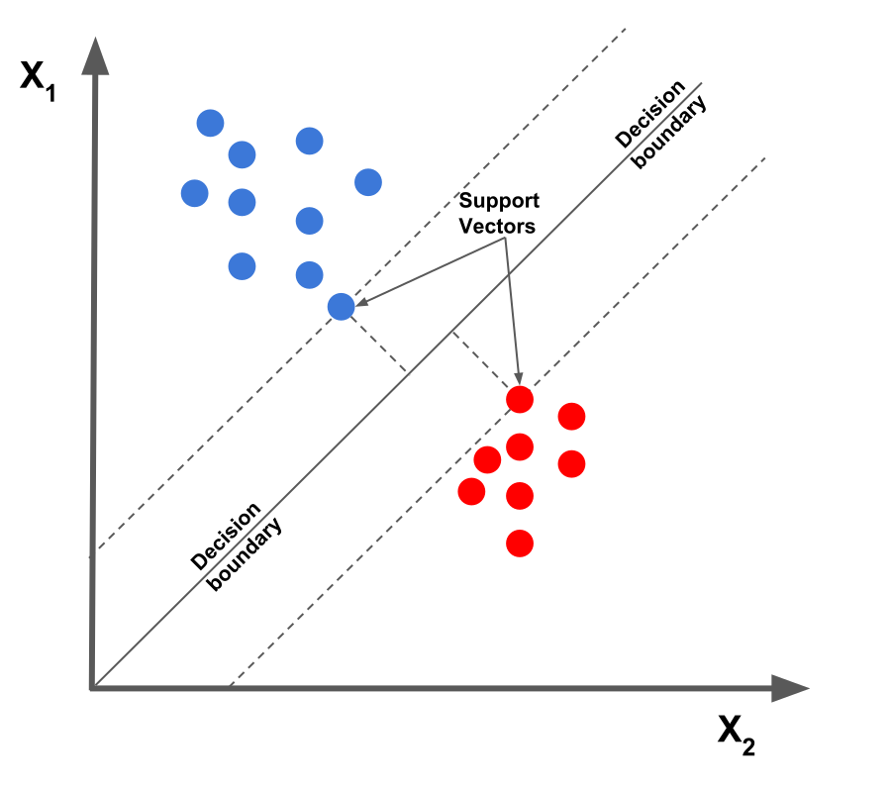
SUPPORT VECTOR MACHINE - ?
It is a supervised machine learning algorithm .
This means , SVM trains on data which is labeled ,studies it , recognizes and classify the new data as per its previous learning
Support vectors: data points which lie close to the hyperplane .
Mainly used to categorize data into different classes .
SVM consist of a hyperplane which acts as a decision boundary in differentiating it into various classes .
It can also generate multiple hyperplanes where it divides data into various segments .
Here , each segment will contain only one kind of data .

Slide 10
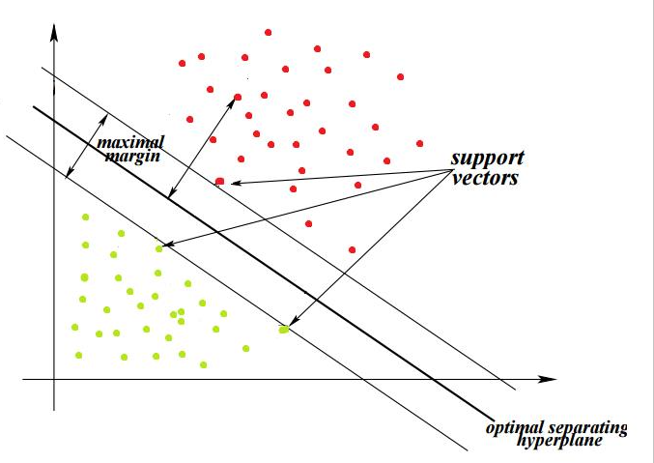
SUPPORT VECTOR MACHINE :
Here , each segment will contain only one kind of data .
SVMs maximize the margin around the separating hyperplane. A.k.a. large margin classifiers
The decision function is fully specified by a subset of training samples, the support vectors.
Solving SVMs is a quadratic programming problem
Seen by many as the most successful current text classification method

Slide 11
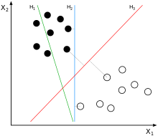
SUPPORT VECTOR MACHINE :
SVM also used for both classification and regression techniques
It indeed uses kernel trick for non-linear data .
“ kernel trick transforms data into another dimension which has a clear dividing margin between different classes of data “
Support Vector Machine (SVM) finds an optimal* solution.
Maximizes the distance between the hyperplane and the “difficult points” close to decision boundary
One intuition: if there are no points near the decision surface, then there are no very uncertain classification decisions .

Slide 12
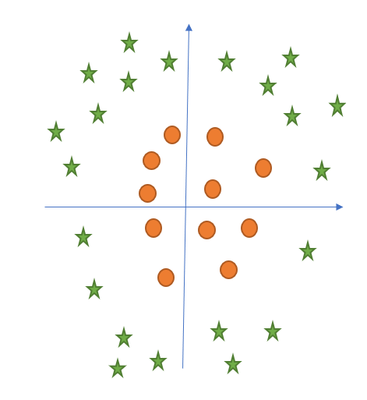
SUPPORT VECTOR MACHINE –NON LINEAR DATA:
What can we do in this case ? Clearly, there is no line that can separate the two classes in this x-y plane.
Z
Y
We apply transformation and add one more dimension as we call it z-axis.
Lets assume value of points on z plane, w = x² + y².
In this case we can manipulate it as distance of point from z-origin. Now if we plot in z-axis, a clear separation is visible and a line can be drawn .

Slide 13
SUPPORT VECTOR MACHINE –NON LINEAR DATA:
Transforming back this line to original plane, it maps to circular boundary.
These transformation are known as kernels.
The function of kernel is to take data as input and transform it into the required form.
Different SVM algorithms use different types of kernel functions.
SVM Kernel functions :
Polynomial kernel
Gaussian kernel
Gaussian radial basis function
Sigmoid kernel
Laplace RBF kernel
Hyperbolic tangent kernel
Bessel function of first kind kernel
Anova radial basis kernel
Linear spline kernel in 1D

Slide 14
WHY ONLY SVM ?
Every classification methods have its own merits and demerits , which are more or less important according to the type of data which is being analyzed .
SVMs can be a helpful tool for insolvency analysis, in the case of non-regularity in the data, for example when the data are not regularly distributed or have an unknown distribution.
SVMs are a new promising non-linear, non-parametric classification technique, which already showed good results in the medical diagnostics and other fields.
Main advantage of using SVM is that it uses kernel trick .
By fine exploring and tuning of kernels we can make appropriate feature spaces .

Slide 15
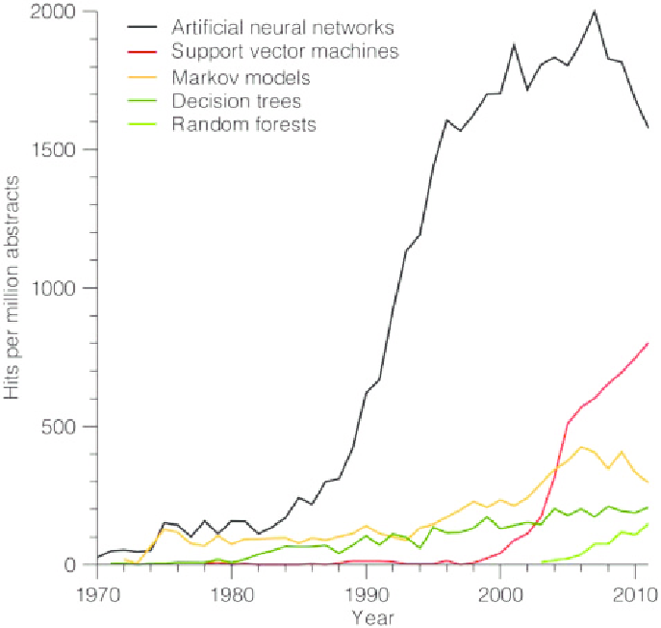
WHY ONLY SVM ?
Performance wise : SVMs using the radial basis function kernel are more likely to perform better as they can handle non-linearities in the data.
Naive Bayes performs best when the features are independent of each other which often does not happen in real.
More efficient in high dimensional spaces .
SVM is memory efficient when compared .

Slide 16
SVM – TUNING PARAMETERS :
The main tuning parameters are :
Kernel
Regularization
Gamma
Margin

Slide 17
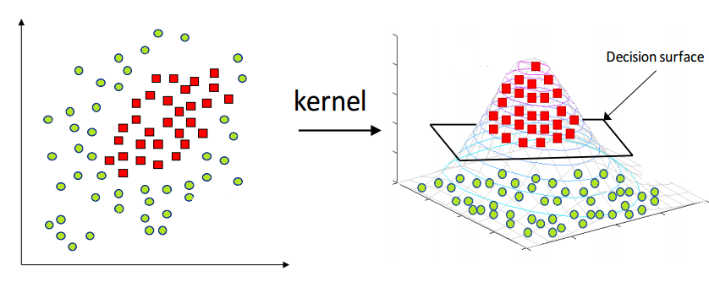
SVM – TUNING PARAMETERS :
KERNEL :
Hyperplane in linear SVM Learns by transforming the problem into some linear algebra .
Linear kernel makes the prediction by using the dot product between the input (x) and support vectors (xi)
equation : f(x) = B(0) + sum(ai * (x , xi))
Calculates inner products of input vector with all supporting vectors in training data .
Coefficients B(0) and ai are calculated from the training data .
Kernel trick - It allows us to operate in the original feature space without computing the coordinates of the data in a higher dimensional space.

Slide 18
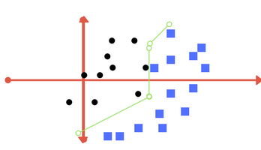
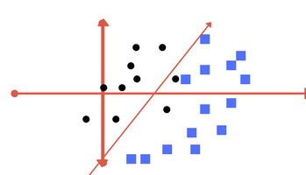
SVM – TUNING PARAMETERS :
REGULARIZATION :
This is depicted as the c parameter in sklearn library .
Mainly calculates the amount of misclassification in svm optimization and helps in avoiding it in each training example .
Higher value of c , smaller margin hyperplane , better classification of training points are done correctly .
Lower the value of c , large margin separating hyperplane , more misclassifying points are there

Slide 19
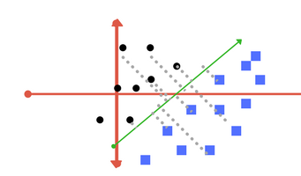
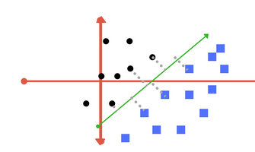
SVM –TUNING PARAMETER
GAMMA :
This parameter determines how far the influence of a single training example reaches .
for low values it means ‘far’ and high values meaning ‘close’.
To be precise , with low gamma, points far away from plausible seperation line are considered in calculation for the seperation line.
Where as high gamma means the points close to plausible line are considered in calculation.
Low gamma
High gamma

Slide 20
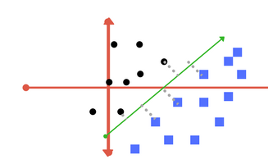
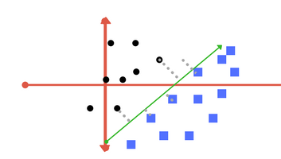
SVM – TUNING PARAMETERS
MARGIN :
Very important characteristic of SVM .
Margin is a line which separates closest class points .
Good margin : equidistant from both the class , separation is larger
Bad margin : very close to the class , tries to cross other class .
SVM always tries to achieve good margin
Good margin
Bad margin

Slide 21
MATHEMATICS BEHIND SVM :
In SVM, we plot the data points as points in an n-dimensional space where n being the number of features we have , and the value of each feature being the value of a particular coordinate.
Hyperplanes - considered decision boundaries that classify data points into their respective classes in a multi-dimensional space .
Hyperplane is a generalization of a plane :
In 2D , it’s a line
In 3D, it’s a plane
In more dimensions we call them hyperplane
Types of SVMs :
Simple SVM: These are used for linear regression and classification problems.
Kernel SVM: Has more flexibility for non-linear data since we can add more features to fit a hyperplane instead of a two-dimensional space.

Slide 22
MATHEMATICS BEHIND SVM :
SVM Classifier :
Hypothesis function :
h(xi) = +1 , if w.x + b >= 0
-1 , if w.x +b < 0
On the hyperplane it is classified as +1
Below the hyperplane it is classified as -1

Slide 23
MATHEMATICS BEHIND SVM :
Kernel functions :
Linear :
Used for text classification since most of these types of problem are linearly seperable .
Works well when lot of features are there .
Faster than most of the others .
Has only few parameters to optimize .
Equation : F(X) = W ^{T} X + b , where w is the weight vector , X is the data that you're trying to classify , b is the linear coefficient estimated from the training data.
Polynomial :
Not used very often since its predictions are not accurate .
Equation : F(X1, X2) =(a + X1^{T} * X2^{T} )^{b}
f(X1, X2) represents the polynomial decision boundary , X1 and X2 represent your data.

Slide 24
MATHEMATICS BEHIND SVM :
Kernel functions :
Gaussian Radial Basis Function (RBF) :
most powerful and commonly used kernels in SVMs.
Best for non-linear data .
Equation : F( X1, X2 ) = exp(-gamma * || X1 – X2 ||² ) where gamma = (1/ 2σ² ⁾
^{F(x1,x2) = e-(||x1-x2||2}
^{2σ 2}
gamma - specifies how much a single training point has on the other data points around it , ||X1 - X2|| is the dot product between the features.
Sigmoid :
Used mainly in neural networks than in SVM
Equation : F(X,Y) = tanh(alpha * X ^{T} * Y + C )

Slide 25

MATHEMATICS BEHIND SVM :
Kernel functions :
Laplace RBF kernel :
It is general-purpose kernel .
Used when there is no prior knowledge about the data.
Equation : K(X,Y) = exp( - $\frac{||X −Y||}{σ} )$
Hyperbolic Tangent kernel :
It is used in neural networks
Equation : K (X,Y) = tanh(alpha X ^{t} Y + c )

Slide 26


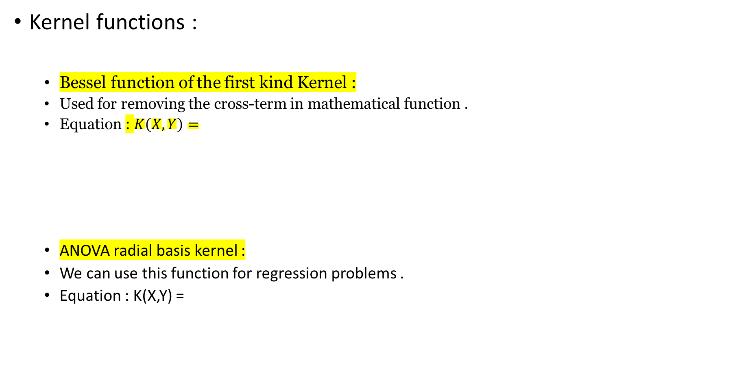
MATHEMATICS BEHIND SVM :
Kernel functions :
Bessel function of the first kind Kernel :
Used for removing the cross-term in mathematical function .
Equation : $K\left(X,Y\right)=$
ANOVA radial basis kernel :
We can use this function for regression problems .
Equation : K(X,Y) =

Slide 27
MATHEMATICS BEHIND SVM :
Kernel functions :
Linear splines kernel in one-dimension :
It is useful when dealing with large sparse data vectors.
It is often used in text categorization.
The splines kernel also performs well in regression problems.
Equation :

Slide 28


PROS AND CONS :
More efficient in high dimensional spaces .
SVM is memory efficient when compared .
Best when classes are seperable .
Hyperplane effected only by support vectors whereas outliers has less impact .
Not suitable for large datasets .
Does not perform well in overlapped conditions .
SVM will not perform if number of features for each data point is greater than no of training data samples .
SVM algorithm has several key parameters that need to be set correctly to achieve the best classification results for any given problem.

Slide 29
DATASET AND PACKAGES EXPLAINED :
The dataset we have used in this project is from UCI Machine learning repository .
Features included in the dataset are :
Dependent variables :
Age , sex,chest pain type, BP, cholestrol , FBS over 120 , EKG results ,Max HR , exercise angina , ST Depression,Slope of ST , Number of vessels fluro ,Thallium , Heart_disease .
Independent Variables:
Heart_disease
Here we have used binary encoding format for making the values of heart disease into binary format

Slide 30
HOW THE MODEL WORKS :
Importing the dataset and also getting the risky factors associated with the data
Exploring the data to figure out what they look like
Pre-processing the data
Split the data into attributes and labels
Divide the data into training and testing sets
Train the SVM algorithm
Make some predictions
Evaluate the results of the algorithm

Slide 31
PRE-REQUISITES :
Scikit-learn
Tensorflow 2.3
Pandas
Seaborn
Matplotlib

Slide 32

SCIKIT LEARN :
It is a software library for machine learning .
They are used together with the scientific Python libraries SciPy and NumPy.
The library is characterized by its robust and well-documented functions.
Scikit-learn is mostly written in Python.

Slide 33
SCIKIT LEARN :
These are well suited for supervised and unsupervised learning .
simple and efficient tools for machine learning, data mining and data analysis
Functions include :
Clustering
Cross validation
reduction
Feature extraction
Parameter tuning

Slide 34
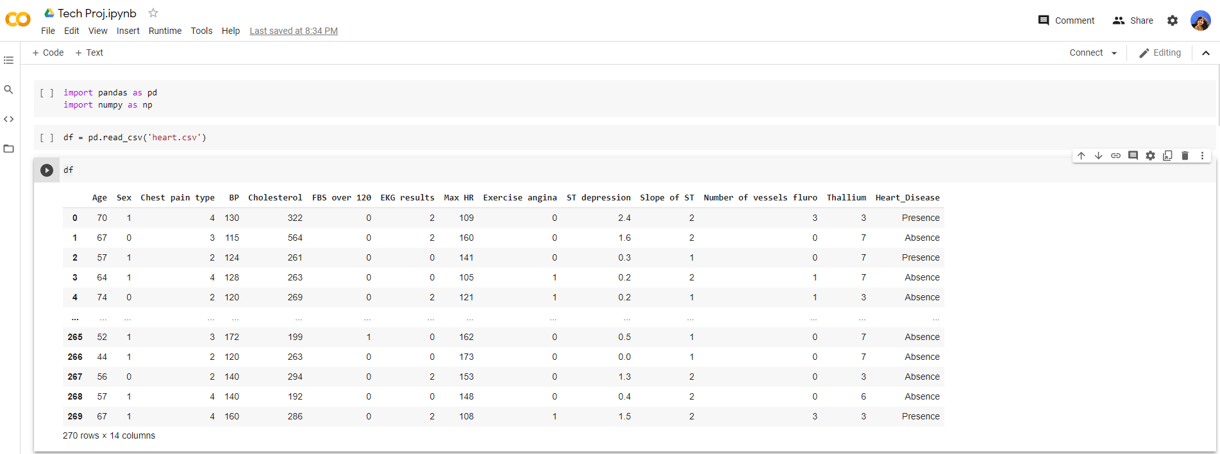
CODE :
importing the libraries pandas and numpy
Creating data frame by importing a csv file using pandas Reading the dataset

Slide 35
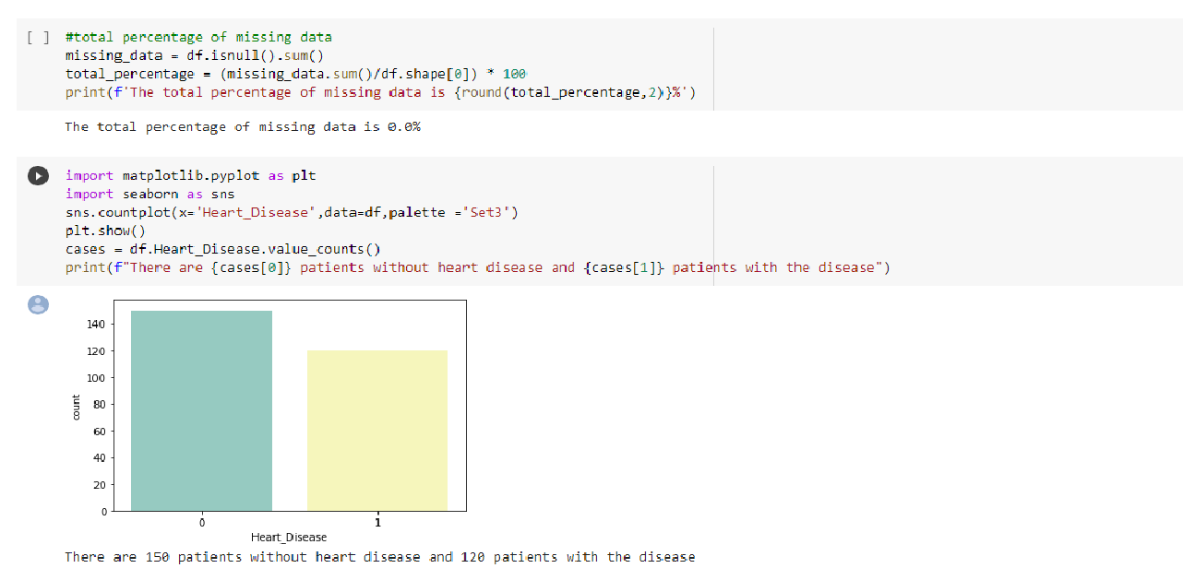
CODE :
Here we are checking if any data has been null or have been missing in the data frame . isnull() method is used when wish to evaluate whether any value is missing in a Series
.sum() - how many missing values exist in the collection
Matplotlib.pyplot is a collection of command style function where pyplot makes changes in the figure like creating a figure , labelling the figure , plotting the areas in the figure etc.
seaborn.countplot is a bar plot where the dependent variable is the number of instances of each instance of the independent variable.
Visualizing how many patients are having heart disease and how many doesn’t have them .

Slide 36
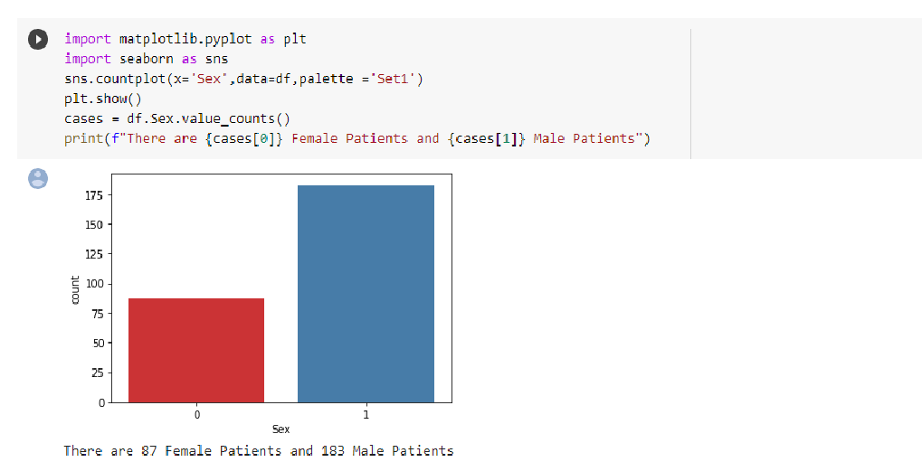
CODE :
Using again the barplot to determine how many male and female patients are present in the dataset .

Slide 37
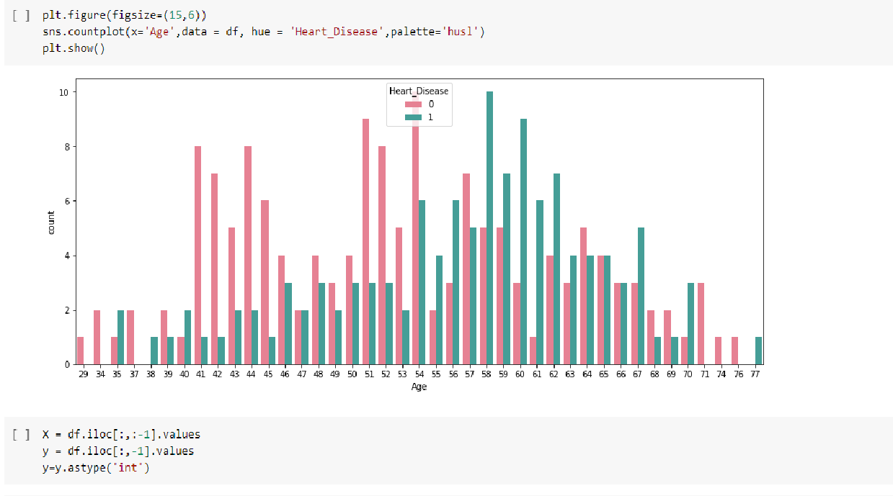
CODE :
Using barplot determining whether heart disease is present or not. If value is 0 then heart disease is absent , if value is 1 then its present .

Slide 38
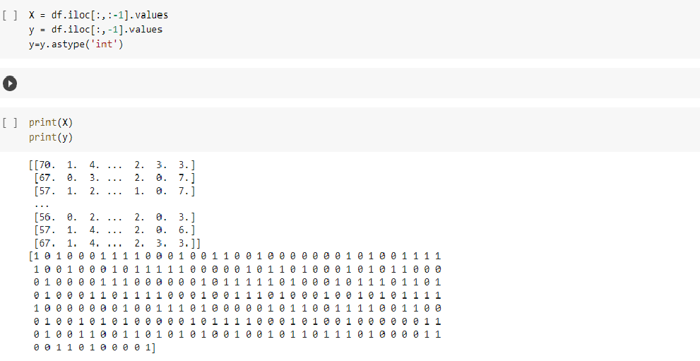
CODE :
iloc[] is primarily integer position based (from 0 to length-1 of the axis), but may also be used with a boolean array. integer-location based indexing for selection by position

Slide 39
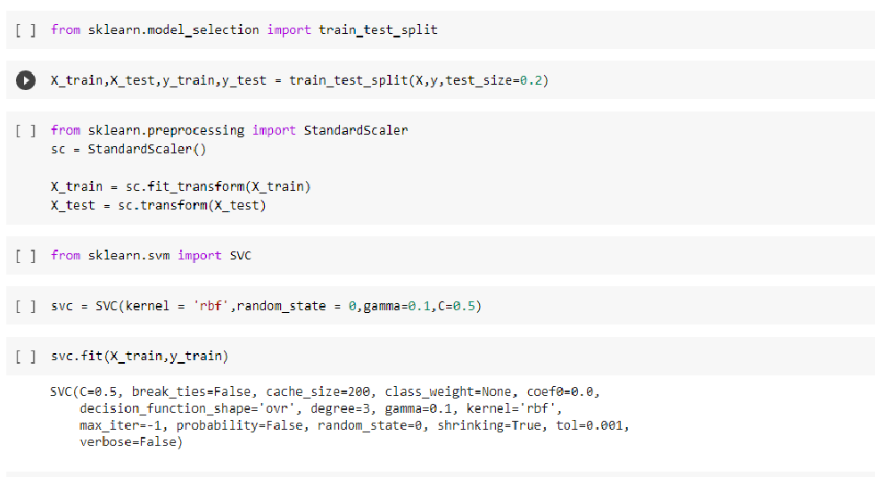
CODE :
Next, we will import model_selection from scikit-learn, and use the function train_test_split( ) to split our data into two sets
Split arrays or matrices into random train and test subsets . By specifying the test_size as 0.2, we aim to put 20% of the data into our test set, and the rest of the data into the training set.
Fit it to data and then transform it
Perform standardization by centering and scaling
Declaring svc module with parameters
C – regularization parameter, The strength of the regularization is inversely proportional to C. Must be strictly positive
Kernel -specifies the kernel type to be used in the algorithm. It must be one of ‘linear’, ‘poly’, ‘rbf’, ‘sigmoid’, ‘precomputed’ or a callable. If none is given, ‘rbf’ will be used.
Degree - Degree of the polynomial kernel function (‘poly’).
Gamma -Kernel coefficient for ‘rbf’.
Coef0 -Independent term in kernel function. It is only significant in polynomial and sigmoid kernels..
Probablity-Whether to enable probability estimates.
Cache size - Specify the size of the kernel cache (in MB).
Class_weight -Set the parameter C of class i to class_weight[i]*C for SVC. If not given, all classes are supposed to have weight one.
Verbose - this setting takes advantage of a per-process runtime setting in libsvm that, if enabled, may not work properly in a multithreaded context.

Slide 40
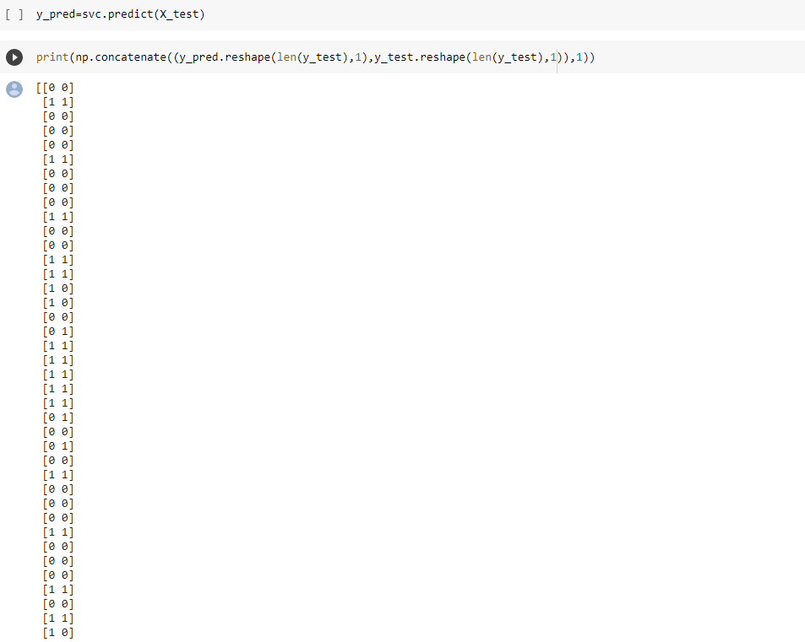
CODE :

Slide 41
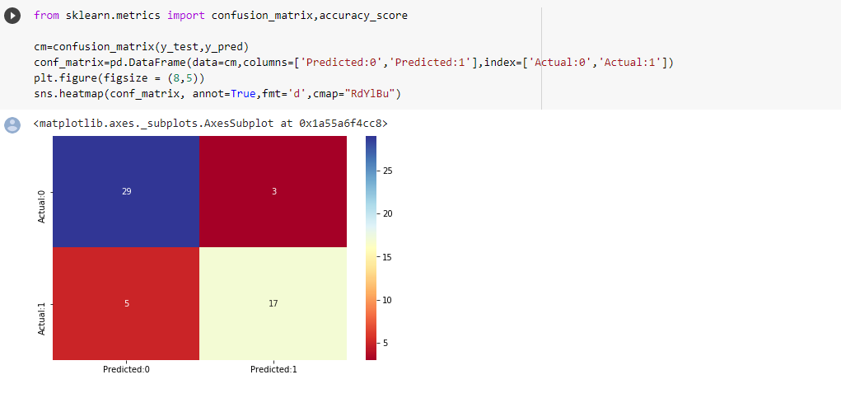
CODE :
Confusion matrix is a table with two rows and two columns that reports the number of false positives, false negatives, true positives, and true negatives.
Each row in a confusion matrix represents an actual class, while each column represents a predicted class.

Slide 42
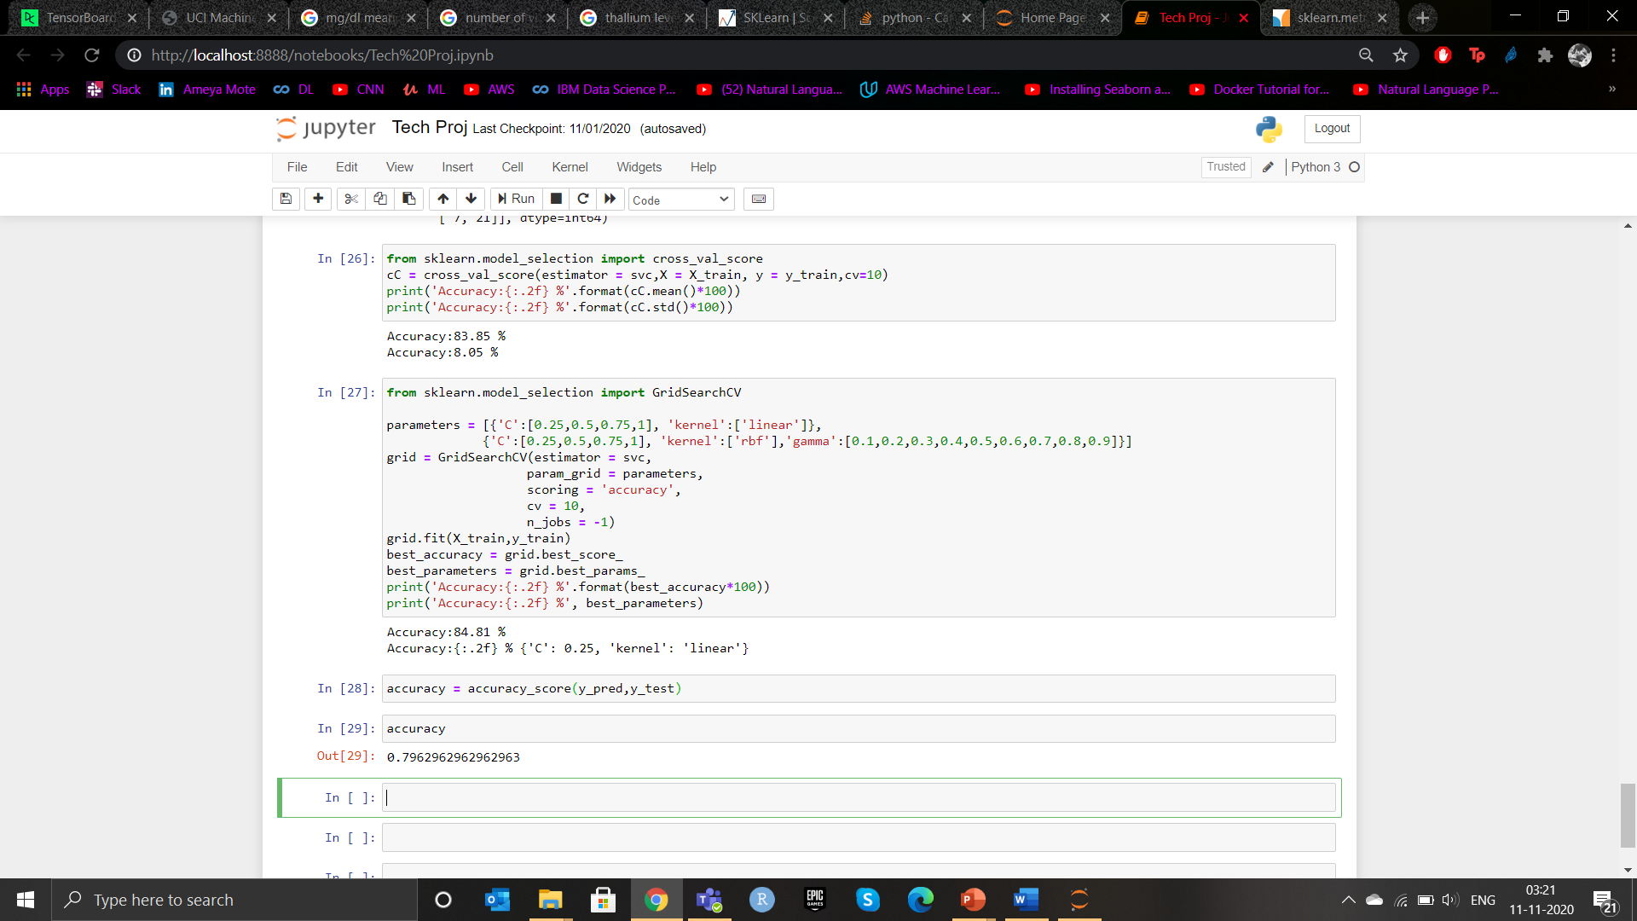
CODE :
Achieved an accuracy rate of 83.85% for mean value of sklearn
Achieved an accuracy rate of 8.05 % for standard deviation of sklearn model

Slide 43

TENSORFLOW 2.3 :
TensorFlow is an end-to-end open source platform for machine learning
TensorFlow is more of a low-level library .
Basically, TensorFlow acts as the Lego bricks (similar to NumPy and SciPy) that we can use to implement machine learning algorithms .
It basically has comprehensive, flexible ecosystem of tools, libraries and community resources
Whereas scikit-learn comes with off-the-shelf algorithms, e.g., algorithms for classification such as SVMs, Random Forests, Logistic Regression, and many, many more.

Slide 44
TENSORFLOW 2.3 :
TensorFlow provides better results if we want to implement deep learning algorithms, since it allows us to take advantage of GPUs for more efficient training.
makes it easier for us to load and preprocess data, and to solve input-pipeline bottlenecks, whether we are working on one machine, or many.
TensorFlow was originally developed by the Google .

Slide 45
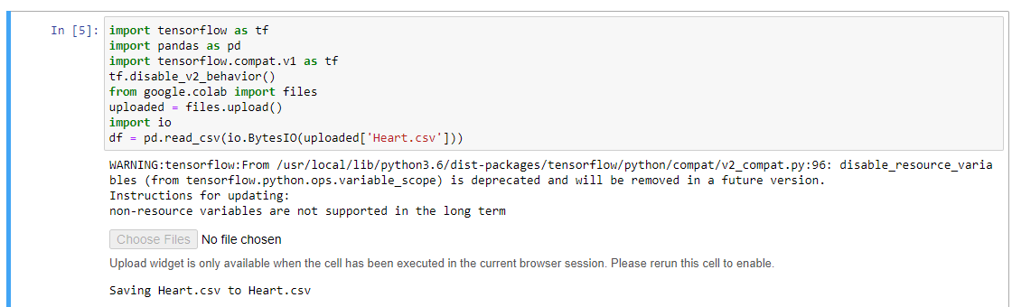
SVM : TENSORFLOW
Importing libraries tensorflow under alias tf and pandas library under alias pd
Importing the files from google colab and uploading it
Reading the csv file which contains our heart dataset

Slide 46
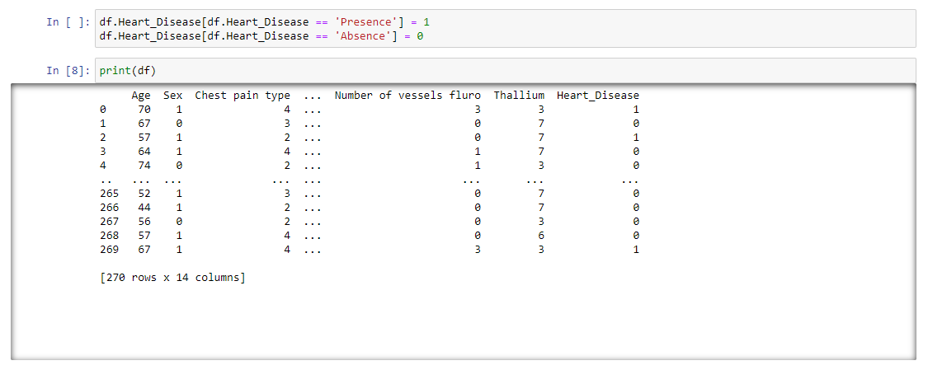
SVM : TENSORFLOW
Using binary encoding format making the values of heart disease into binary format

Slide 47
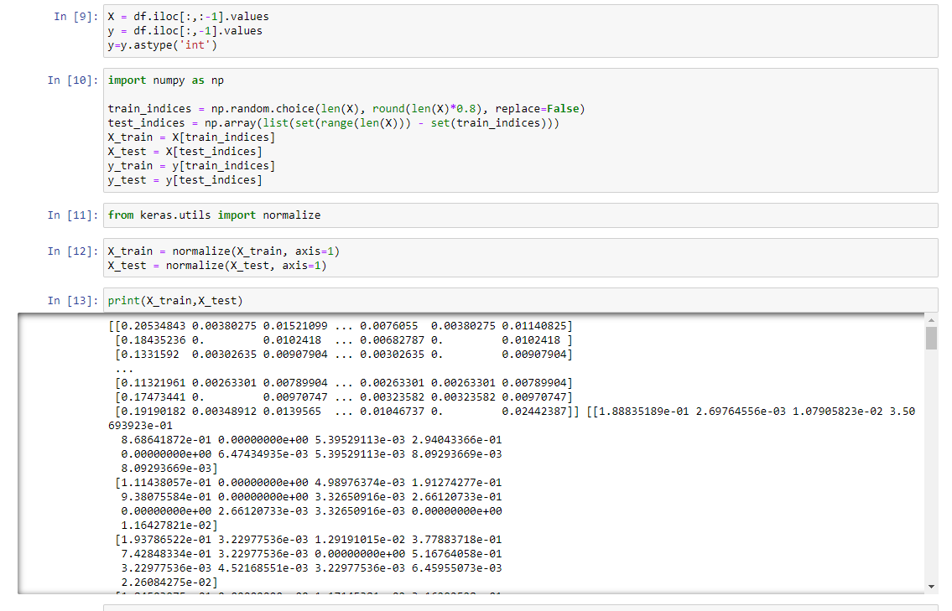
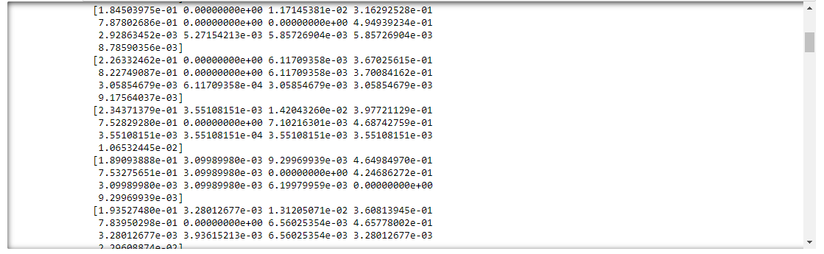
SVM : TENSORFLOW
gives the row vector of the last column's values . integer-location based indexing for selection by position .
Splitting the numpy array into trainset and test set .
Normalizing the numpy array

Slide 48
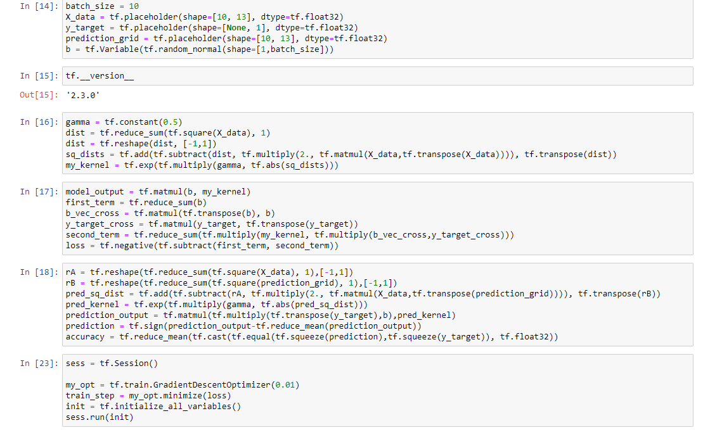
SVM : TENSORFLOW
Declare batch size as 10
Initialising placehoders. Placeholder is a variable we assign to data which allows us to create our operations and builds computational graph without the need of data
Gamma variable as used for tuning . For low values points are far amd for higher values points are close .Gaussian RBF kernel .
tf.session() allows to execute the graphs and holds actual values of variables and intermediate results .
function does Reshape /batch multiplication.

Slide 49
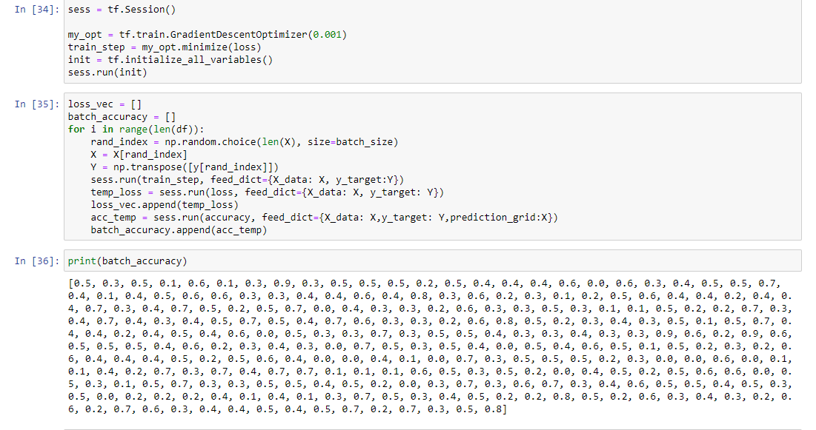
SVM : TENSORFLOW
Training the loop
Obtained accuracy of 80% in tensorflow

Slide 50
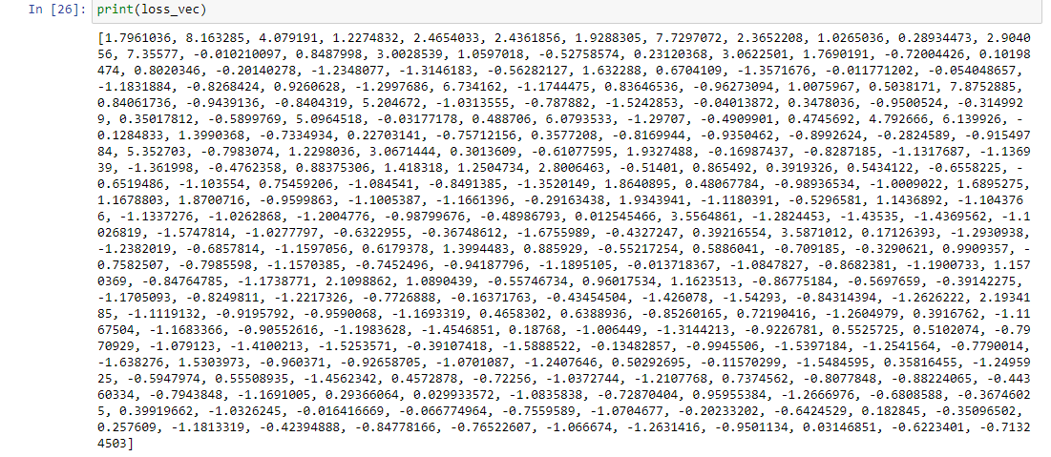
SVM : TENSORFLOW

Slide 51
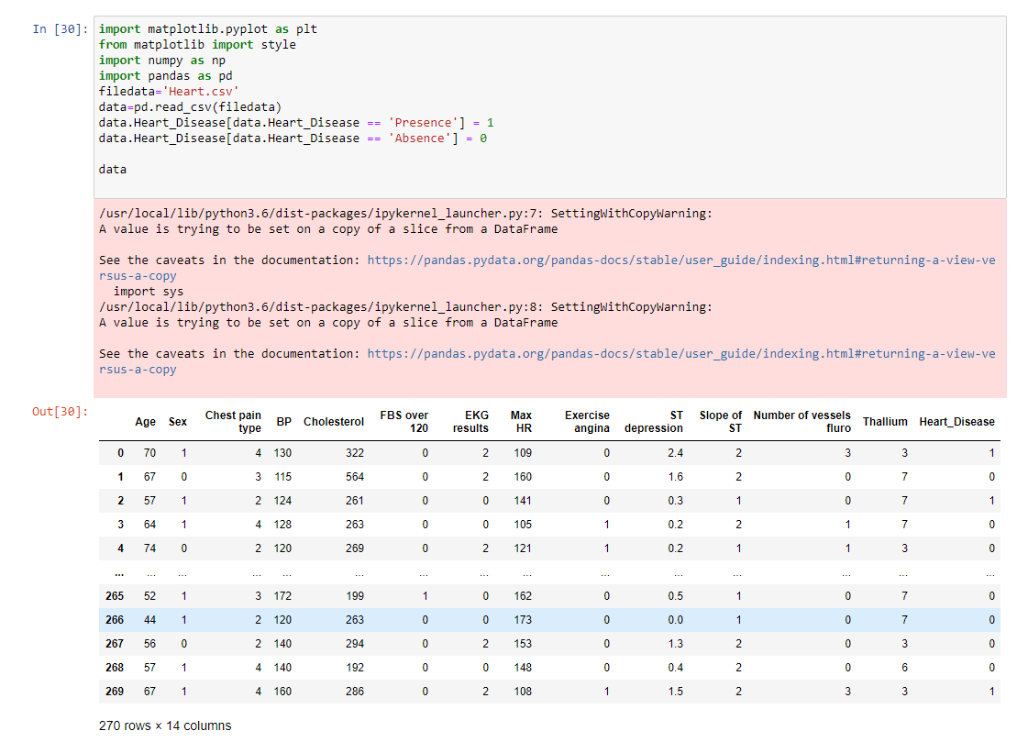
SVM : TENSORFLOW
Importing the libraries matplotlib , numpy and pandas

Slide 52
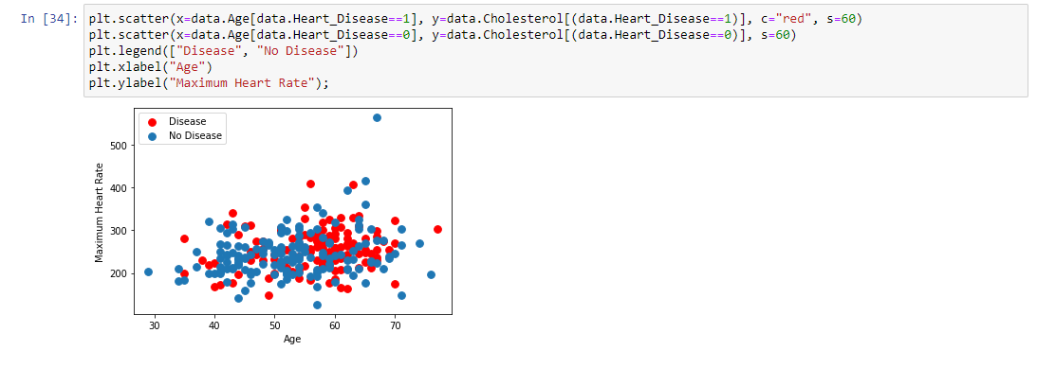
SVM : TENSORFLOW
Plot using scatterplot to determine people having heart disease and not having disease

Slide 53
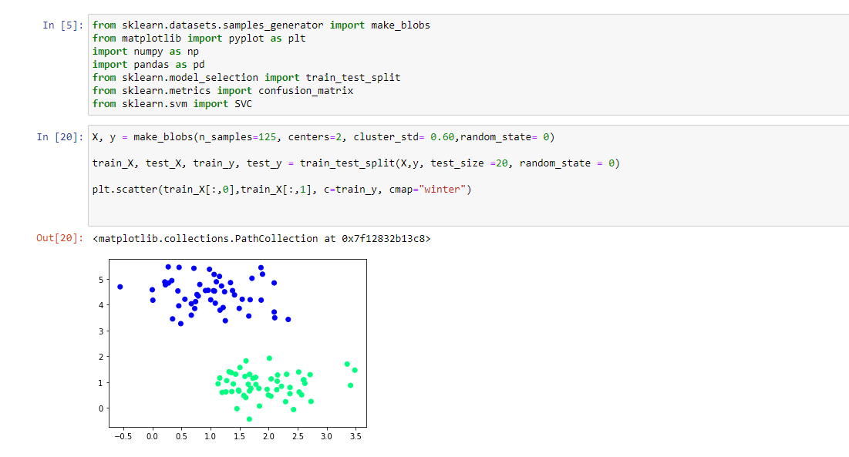
SVM : TENSORFLOW
Generate gaussian blobs for clustering
Cluster_std : standard deviation of clusters
Centers : generating fixed center location

Slide 54
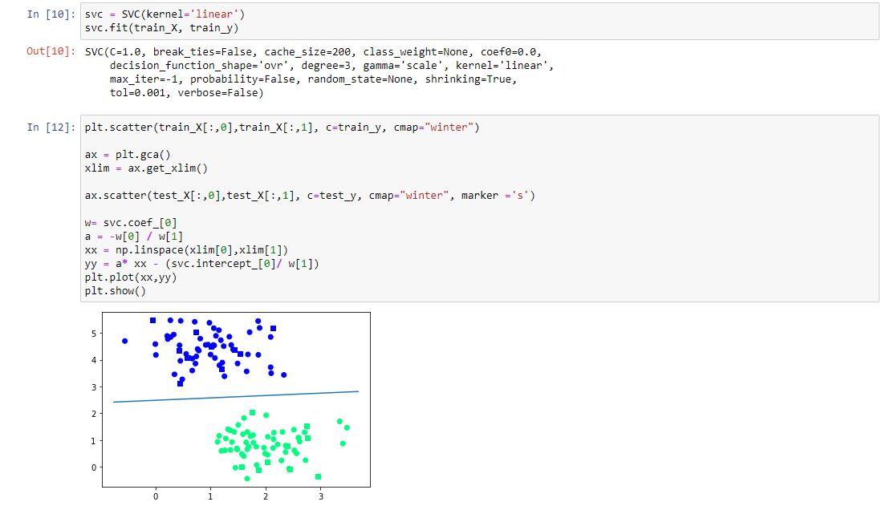
SVM : TENSORFLOW
Creating linear kernel model

Slide 55
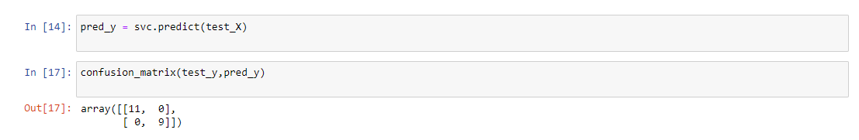
SVM : TENSORFLOW

Slide 56
FINDINGS AND CONCLUSION :
From the result we were clearly able to categorize and differentiate people having heart disease and absence of heart disease .
120 patients with heart disease
150 patients without heart disease
Categorized male and female patients from the data .
87 female patients
183 male patients
People with heart disease have been marked “1”i.e the disease is present, marked “0” for absence of disease
Trained the individual parameters.
Achieved accuracy rate of 80 % in TensorFlow
Achieved accuracy rate of 79.6 % in SVM

Slide 57

REFERENCES :
https://dzone.com/articles/support-vector-machine-in-r-using-svm-to-predict-h
https://www.ahajournals.org/doi/10.1161/CIR.0000000000000757
https://towardsdatascience.com/heart-disease-risk-assessment-using-machine-learning-83335d077dad
https://archive.ics.uci.edu/ml/datasets/Heart+Disease
https://www.ijraset.com/fileserve.php?FID=19814
https://www.tensorflow.org/tensorboard/get_started

Slide 58

THANK YOU

